Slide 1
Params [3 5]

Slide 2
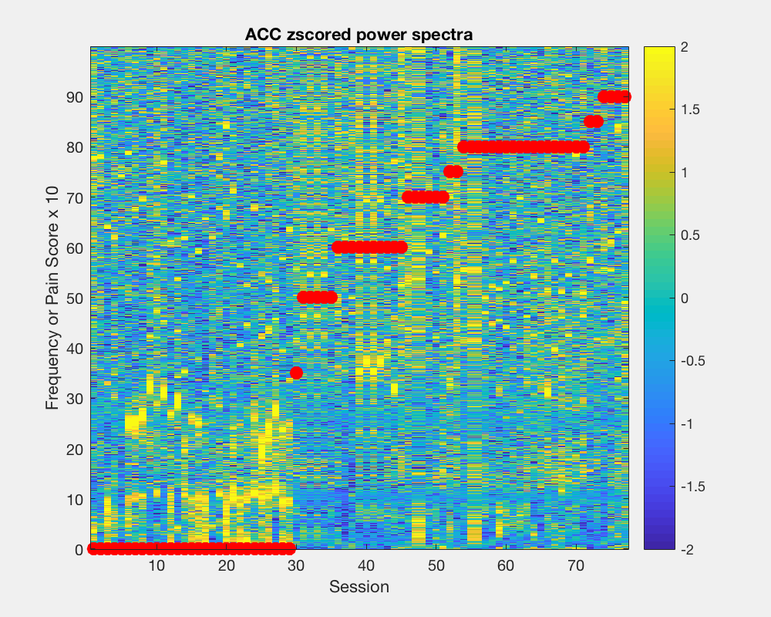
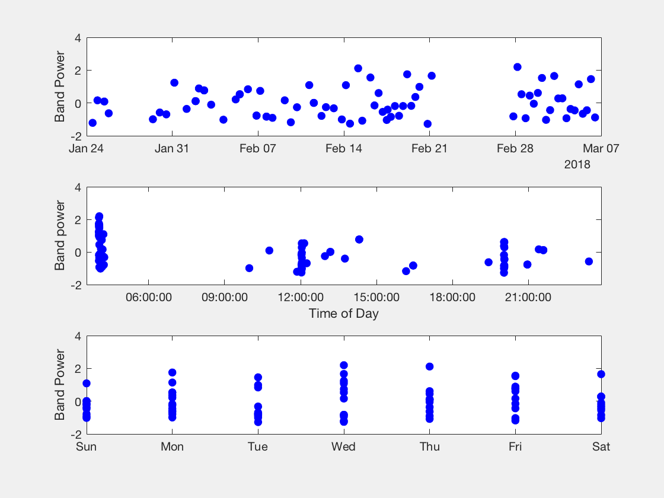


Slide 3
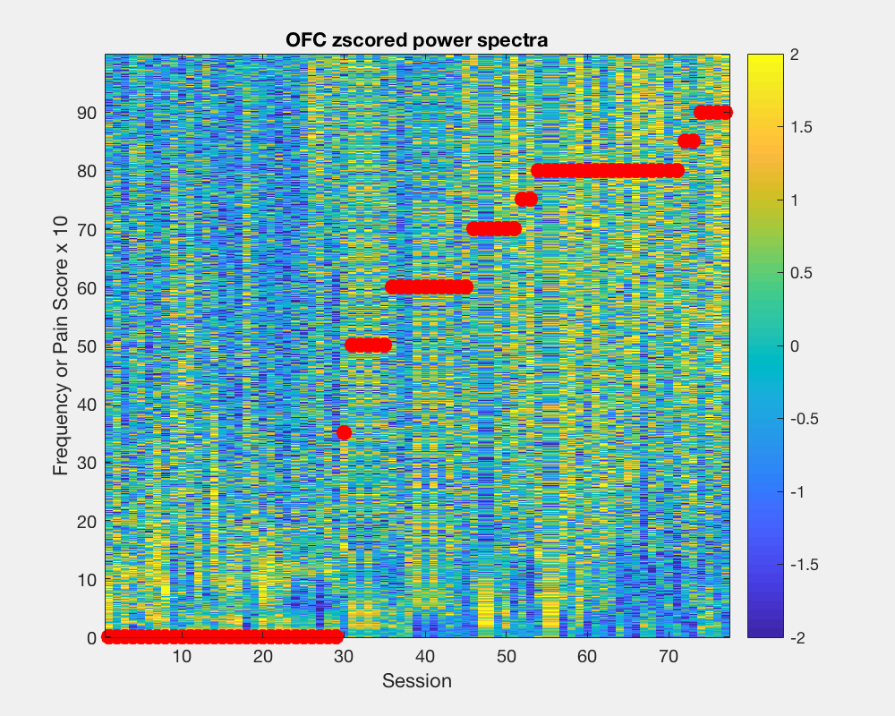

Slide 4
Params [300 5]

Slide 7
Params [120 15]
Bandwidth = 2
Looks similar to [300 15]

